Slide 1
US Consumer Finance Complaints The Problem
Financial products are known to lack transparency. By analyzing a dataset on recent financial complaints and gathering insights on where the complaints are coming from, these insights may help consumer be better prepared
Complaints are an indication of market failure and an opportunity to address and improve the existing products
Consumers can see where most of the complaints are and this will allow them to navigate away from the business and products that have the most number of complaints
Aggregating complaints will allow Banks to see where their competition are and how they are performing relative to the market

Slide 2
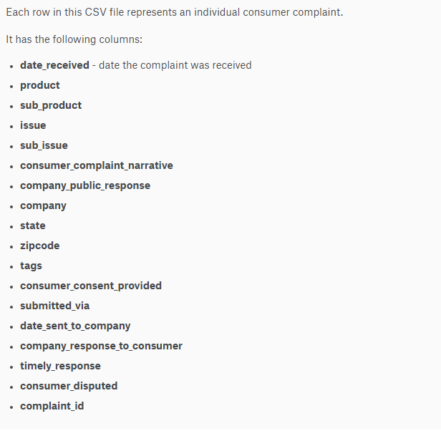
US Consumer Finance Complaints The Data
https://www.kaggle.com/cfpb/us-consumer-finance-complaints

Slide 3
US Consumer Finance Complaints The Hypothesis
Certain companies will have a majority of complaints
There will be cluster around certain categories of complaints/products
Ex. A few categories types will gather the majority of complaints from x number of companies
Mortgages will have a highest # of complaints amongst all the financial products

Slide 4
Lending Club Loan Data The Problem
With all credit and loan products, there is a risk of default
With Lending Club, this information will be of interest both to the company as well as the peers that are funding the loans

Slide 5
Lending Club Loan Data The Dataset
https://www.kaggle.com/wendykan/lending-club-loan-data
Columns = [index, id, member_id, loan_amnt, funded_amnt, funded_amnt_inv, term, int_rate, installment, grade, sub_grade, emp_title, emp_length, home_ownership, annual_inc, verification_status, issue_d, loan_status, pymnt_plan, url, desc, purpose, title, zip_code, addr_state, dti, delinq_2yrs, earliest_cr_line, inq_last_6mths, mths_since_last_delinq, mths_since_last_record, open_acc, pub_rec, revol_bal, revol_util, total_acc, initial_list_status, out_prncp, out_prncp_inv, total_pymnt, total_pymnt_inv, total_rec_prncp, total_rec_int, total_rec_late_fee, recoveries, collection_recovery_fee, last_pymnt_d, last_pymnt_amnt, next_pymnt_d, last_credit_pull_d, collections_12_mths_ex_med, mths_since_last_major_derog, policy_code, application_type, annual_inc_joint, dti_joint, verification_status_joint, acc_now_delinq, tot_coll_amt, tot_cur_bal, open_acc_6m, open_il_6m, open_il_12m, open_il_24m, mths_since_rcnt_il, total_bal_il, il_util, open_rv_12m, open_rv_24m, max_bal_bc, all_util, total_rev_hi_lim, inq_fi, total_cu_tl, inq_last_12m]

Slide 6
Lending Club Loan Data Hypothesis
Based on evaluating certain factors, one can predict the likelihood of whom will default on their loan payments

Slide 7
Recipes by Food and Nutrition The Problem
It is difficult to balance eating healthy and eating delicious foods. By analyzing over 20,000 recipes, we can predict popular recipes that are both healthy and tasty
This information will be of interest to restaurants/food operations as well as home cooks

Slide 8
Recipes by Food and Nutrition The Dataset
https://www.kaggle.com/hugodarwood/epirecipes
Recipes from Epicurious by recipe title rating, calories, protein, fat, sodium content, #cakeweek, #wasteless, 22-minute meals, 3-ingredients recipes, 30 days of groceries, advance prep required, ingredients

Slide 9
Recipes by Food and Nutrition The Hypothesis
Certain ingredients will serve as the basis for many recipes that are both popular and nutritious
Popular will be defined as the recipes that receive a high tasty rating

